Slide 1
Why NO-SQL ?
Three interrelated megatrends
Big Data
Big Users
Cloud Computing
are driving the adoption of NoSQL technology.

Slide 2
Why NO-SQL ?
Google, Amazon, Facebook, and LinkedIn were among the first companies to discover the serious limitations of relational database technology for supporting these new application requirements.
Commercial alternatives didn’t exist, so they invented new data management approaches themselves. Their pioneering work generated tremendous interest because a growing number of companies faced similar problems.
Open source NoSQL database projects formed to leverage the work of the pioneers, and commercial companies associated with these projects soon followed.

Slide 3
Why NO-SQL ?
1,000 daily users of an application was a lot and 10,000 was an extreme case.
Today, most new applications are hosted in the cloud and available over the Internet, where they must support global users 24 hours a day, 365 days a year.
More than 2 billion people are connected to the Internet worldwide – and the amount time they spend online each day is steadily growing – creating an explosion in the number of concurrent users.
Today, it’s not uncommon for apps to have millions of different users a day.

Slide 4
Introduction
New Generation Databases mostly addressing some of the points
being non-relational
distributed
Opensource
and horizontal scalable.
Multi-dimensional rather than 2-D (relational)
The movement began early 2009 and is growing rapidly.
characteristics :
schema-free
Decentralized Storage System
easy replication support
simple API, etc.

Slide 5
Introduction
Application needs have been changing dramatically, due in large part to three trends: growing numbers of users that applications must support growth in the volume and variety of data that developers must work with; and the rise of cloud computing.
NoSQL technology is rising rapidly among Internet companies and the enterprise because it offers data management capabilities that meet the needs of modern application:
Greater ability to scale dynamically to support more users and data
Improved performance to satisfy expectations of users wanting highly responsive applications and to allow more complex processing of data.
NoSQL is increasingly considered aviable alternative to relational databases, and should be considered particularly for interactive web and mobile applications.

Slide 6
No-SQL (Examples)
Cassandra
MongoDB
Ealsticsearch
Hbase
CouchDB
StupidDB
Etc.

Slide 7
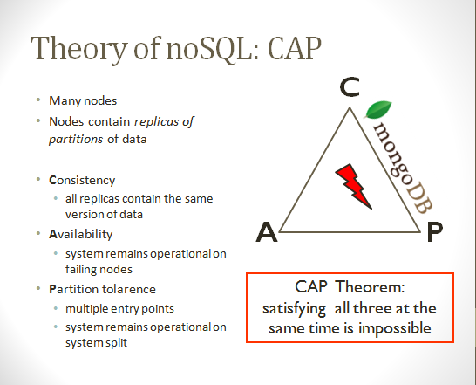
No-SQL

Slide 8
Cassandra
Cassandra is a distributed storage system for managing very large amounts of data spread out across many commodity servers.
while providing highly available service with no single point of failure.
Cassandra aims to run on top of an infrastructure of hundreds of nodes At this scale, small and large components fail continuously.
The way Cassandra manages the persistent state in the face of these failures drives the reliability and scalability of the software systems relying on this service.
Cassandra system was designed to run on cheap commodity hardware and handle high write throughput while not sacrificing read efficiency.

Slide 9
Cassandra
Facebook runs the largest social networking platform that serves hundreds of millions users at peak times using tens of thousands of servers located in many data centers around the world.
There are strict operational requirements on Facebook's platform in terms of performance, reliability and efficiency, and to support continuous growth the platform needs to be highly scalable.
Dealing with failures in an infrastructure comprised of thousands of components is standard mode of operation
There are always a small but significant number of server and network components that are failing at any given time. As such, the software systems need to be constructed in a manner that treats failures as the norm rather than the exception.

Slide 10
Cassandra
Cassandra is now deployed as the backend storage system for multiple services within Facebook.
To meet the reliability and scalability needs described above Facebook has developed Cassandra.
Cassandra was designed to full the storage needs of the Search problem.

Slide 11
Data Model (Cassandra)
Cassandra is a distributed key-value store.
A table in Cassandra is a distributed multi dimensional map indexed by a key. The value is an object which is highly structured.
The row key in a table is a string with no size restrictions, although typically 16 to 36 bytes long.
Every operation under a single row key is atomic per replica no matter how many columns are being read or written into.
Columns are grouped together into sets called column families.
Cassandra exposes two kinds of columns families, Simple and Super column families.
Super column families can be visualized as a column family within a column family.

Slide 12
Architecture (Cassandra)
Cassandra is designed to handle big data workloads across multiple nodes with no single point of failure.
Its architecture is based in the understanding that system and hardware failure can and do occur.
Cassandra addresses the problem of failures by employing a peer-to-peer distributed system where all nodes are the same and data is distributed among all nodes in the cluster.
Each node exchanges information across the cluster every second.
A commit log on each node captures write activity to ensure data durability.

Slide 13
Architecture (Cassandra)
Data is also written to an in-memory structure, called a memtable, and then written to a data file called an SStable on disk once the memory structure is full.
All writes are automatically partitioned and replicated throughout the cluster.
Client read or write requests can go to any node in the cluster.
When a client connects to a node with a request, that node serves as the coordinator for that particular client operation.
The coordinator acts as a proxy between the client application and the nodes that own the data being requested.
The coordinator determines which nodes in the ring should get the request based on how the cluster is configured.

Slide 14
Cassandra (Properties)
Written in: Java
Main point: Best of BigTable and Dynamo
License: Apache
Querying by column
BigTable-like features: columns, column families
Writes are much faster than reads
Map/reduce possible with Apache Hadoop.

Slide 15
MangoDB
What is?
MongoDB is an open source, document-oriented database designed with both scalability and developer agility in mind.
Instead of storing data in tables and rows like as relational database, in MongoDB store JSON-like documents with dynamic schemas(schema-free, schemaless).

Slide 16
MangoDB (Introduction)
Written in: C++
Main point: Retains some friendly properties of SQL
License: AGPL (Drivers: Apache)
Master/slave replication (auto failover with replica sets)
Sharding built-in
Queries are javascript expressions
Run arbitrary javascript functions server-side
Better update-in-place than CouchDB
Uses memory mapped files for data storage
An empty database takes up 192Mb
GridFS to store big data + metadata (not actually an FS)

Slide 17
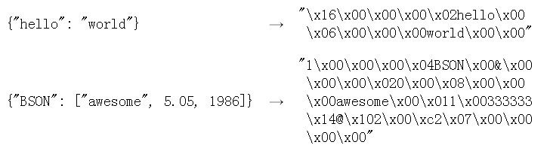
Data Model
Data model: Using BSON (binary JSON), developers can easily map to modern object-oriented languages without a complicated ORM layer.
BSON is a binary format in which zero or more key/value pairs are stored as a single entity.
lightweight, traversable, efficient.

Slide 18
Schema Design
{
"_id" : ObjectId("5114e0bd42…"),
"first" : "John",
"last" : "Doe",
"age" : 39,
"interests" : [
"Reading",
"Mountain Biking ]
"favorites": {
"color": "Blue",
"sport": "Soccer"}
}

Slide 19
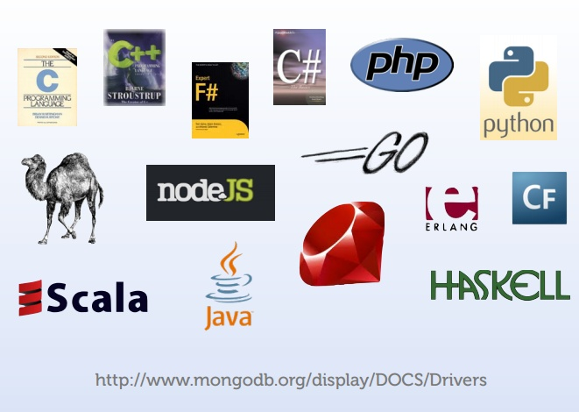
Supported Languages

Slide 20
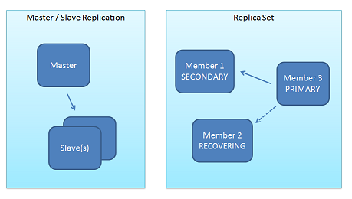
Architecture (MangoDB)
1. Replication
Replica Sets and Master-Slave
replica sets are a functional superset of master/slave.

Slide 21
Architecture (Write process)
All write operation go through primary, which applies the write operation.
write operation than records the operations on primary’s operation log “oplog”
Secondary are continuously replicating the oplog and applying the operations to themselves in a asyn0chronous process.

Slide 22
Why replica sets
Data Redundancy
Automated Failover
Read Scaling
Maintenance
Disaster Recovery(delayed secondary)

Slide 23
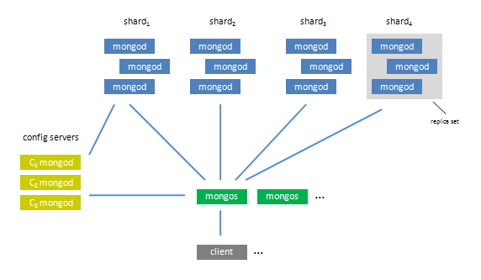
Architecture
2. Sharding
Sharding is the partitioning of data among multiple machines in an order-preserving manner.(horizontal scaling )

Slide 24
Features
Document-Oriented storege
Full Index Support
Replication & High Availability
Auto-Sharding
Querying
Fast In-Place Updates
Map/Reduce

Slide 25
HBase
HBase was created in 2007 at Powerset and was initially part of the contributions in Hadoop.
Since then, it has become its own top-level project under the Apache Software Foundation umbrella.
It is available under the Apache Software License, version 2.0.

Slide 26
Hbase
Features
non-relational
distributed
Opensource
and horizontal scalable.
Multi-dimensional rather than 2-D (relational)
schema-free
Decentralized Storage System
easy replication support
simple API, etc.

Slide 27
Basic Architecture
Tables, Rows, Columns, and Cells
the most basic unit is a column.
One or more columns form a row that is addressed uniquely by a row key.
A number of rows, in turn, form a table, and there can be many of them.
Each column may have distinct value contained in a separate cell.

Slide 28
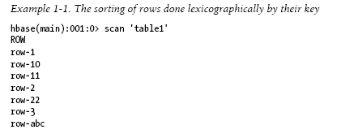
Architecture
All rows are always sorted lexicographically by their row key.

Slide 29
Architecture
Rows are composed of columns, and those, in turn, are grouped into column families.
All columns in a column family are stored together in the same low level storage file, called an HFile.
millions of columns in a particular column family.
There is also no type nor length boundary on the column values.

Slide 30
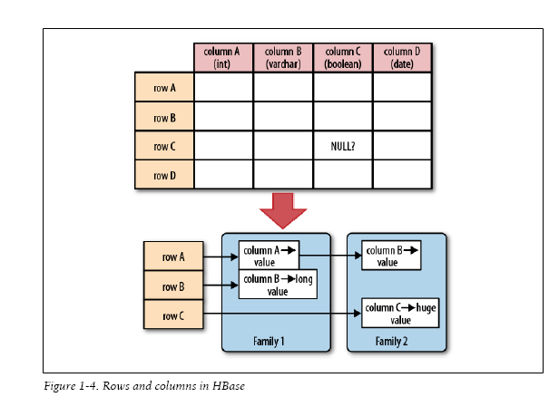
Rows and Columns in HBase

Slide 31
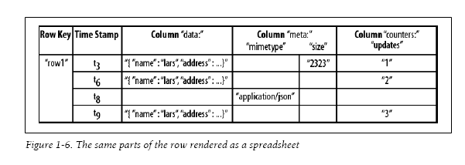
Rows and Columns in HBase

Slide 32
Assignment
1. Storage structure of Google’s BigTable.
2. How NO-SQL deals with Structured and unstructured data

